Slide 1
Travelling Salesman Problem
COSC 507
December 6, 2022
Mohamad Khajezade, Zixiao Zhao, Jumar M. Alam

Slide 2
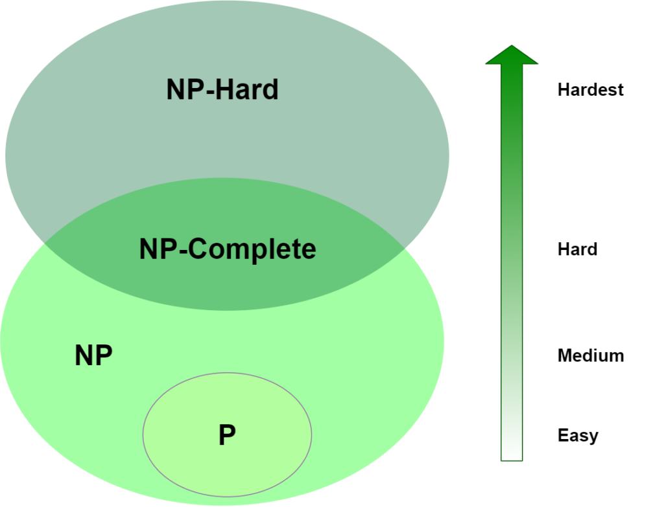
Travelling Salesman Problem (NP-Hard)
TSP is an NP-Hard problem
There is no solution that can be solved in Polynomial time
Some heuristic algorithms are proposed to solve a good solution

Slide 3
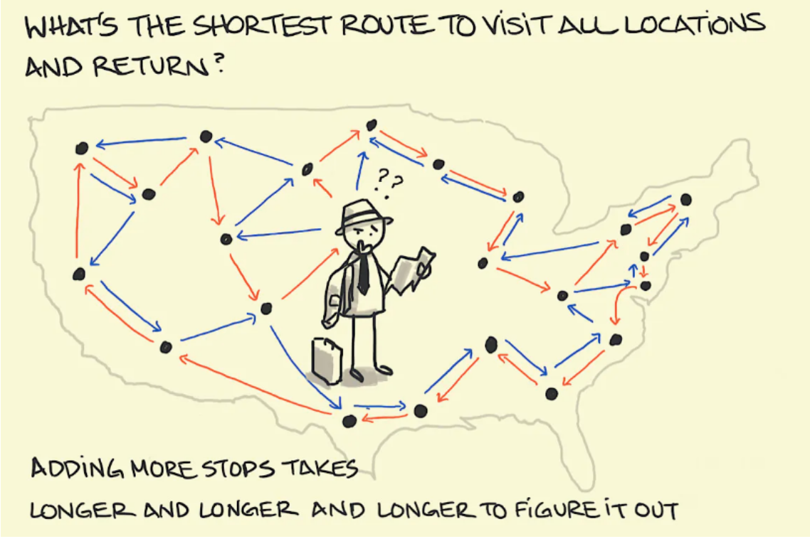
Travelling Salesman Problem - Definition
Given a list of cities and the distances between each pair of cities, what is the shortest possible route that visits each city exactly once and returns to the origin city
In airlines the solution is used to manage
The flight staff arrayments

Slide 4
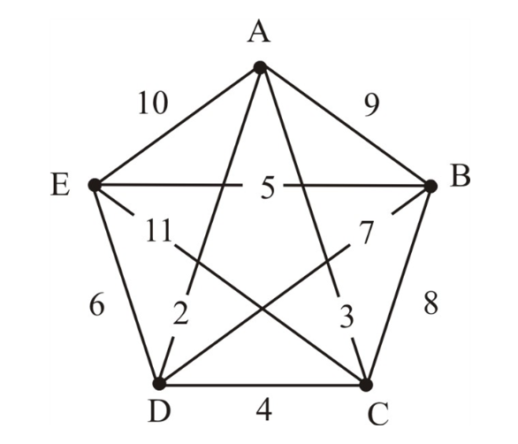
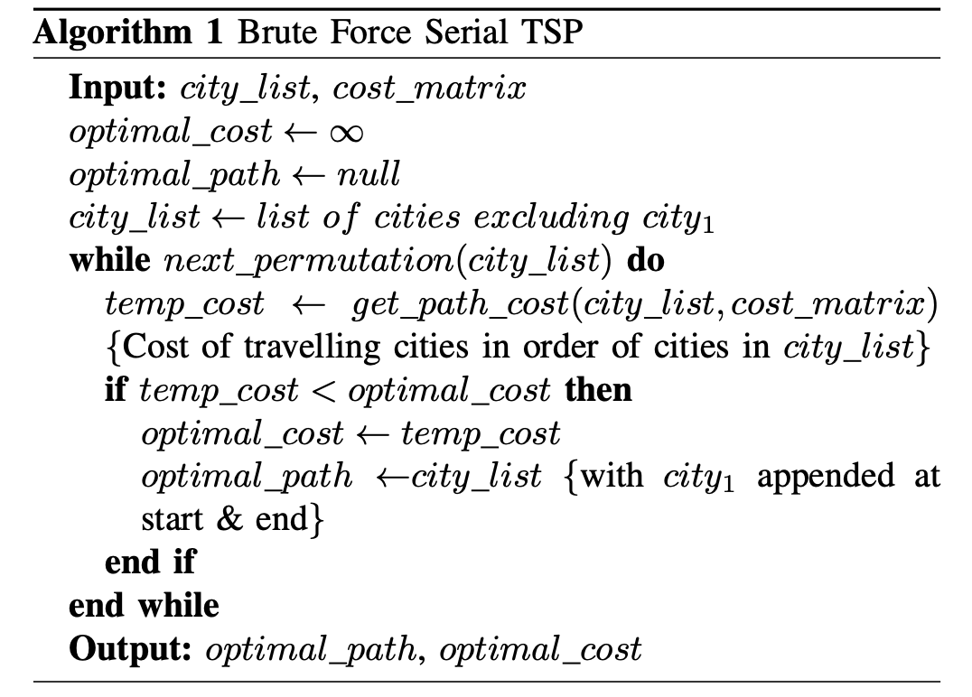
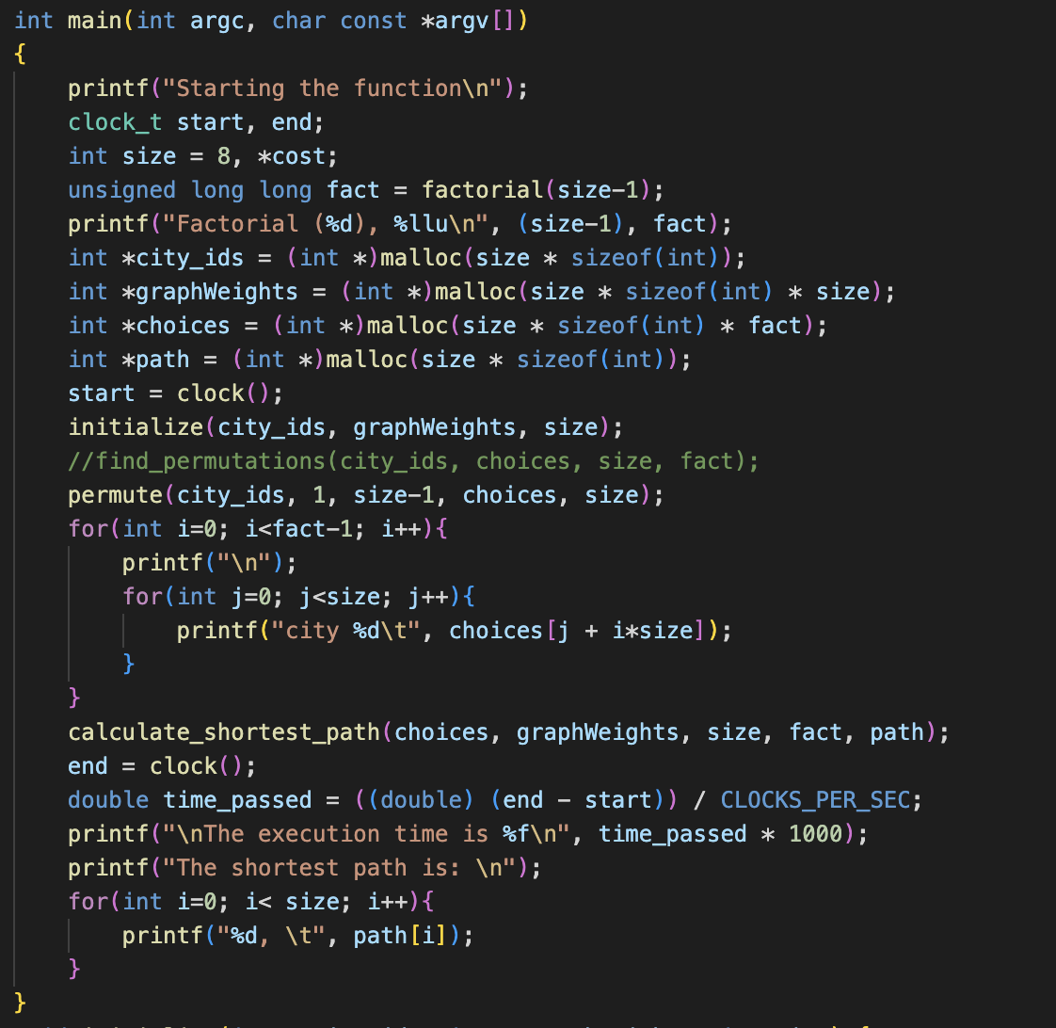
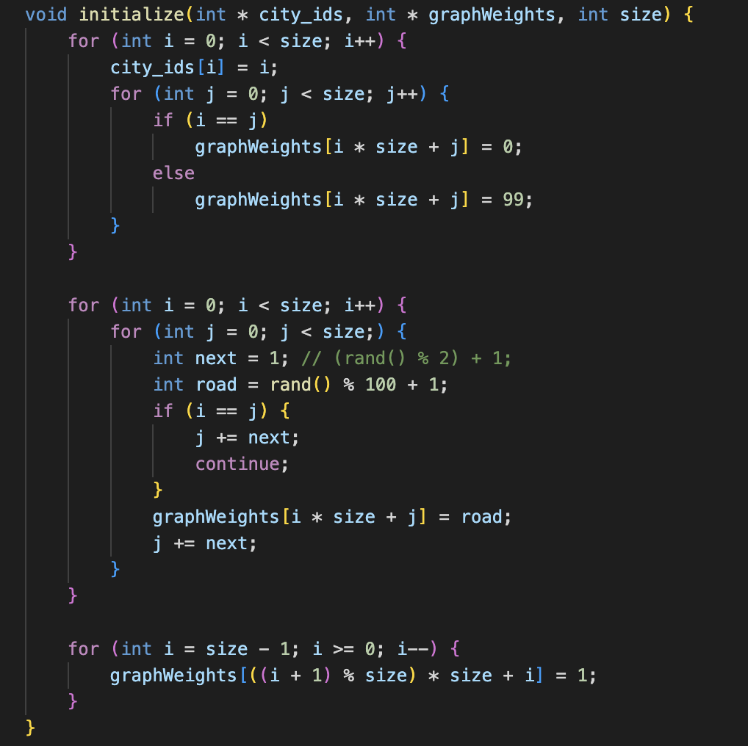
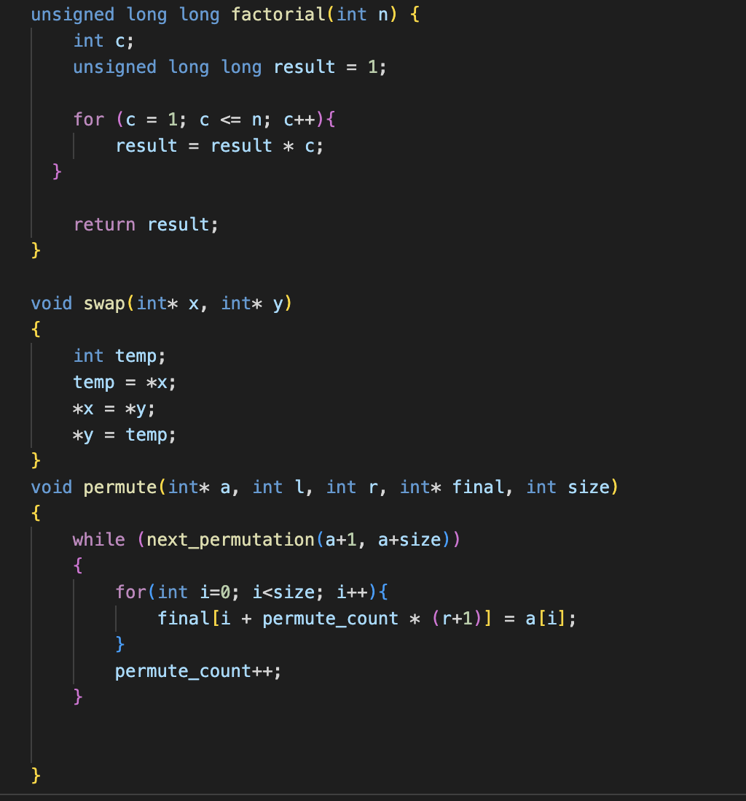
Travelling Salesman Problem - Formulation
Brute Force Algorithm
Considering city A as the starting and ending point
Generate (N-1)! Permutations
Compute the cost of each path
Return the permutation with the minimum cost
The time complexity is O(N!)
0 | 9 | 3 | 2 | 10
9 | 0 | 8 | 7 | 5
3 | 8 | 0 | 4 | 11
2 | 7 | 4 | 0 | 6
10 | 5 | 11 | 6 | 0

Slide 5
Cuda Implementation
Each thread computes a portion of permutations
A shared memory is used for blocks to compute the cost
The results of each block is reduced to compute the minimum cost (shortest path)
Blocks are organized in different grids
Blocks are synchronized by lunching different kernels

Slide 6
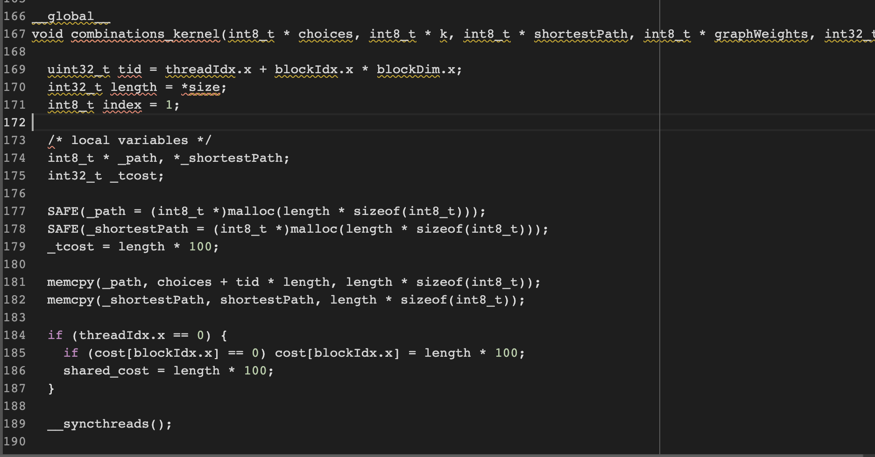
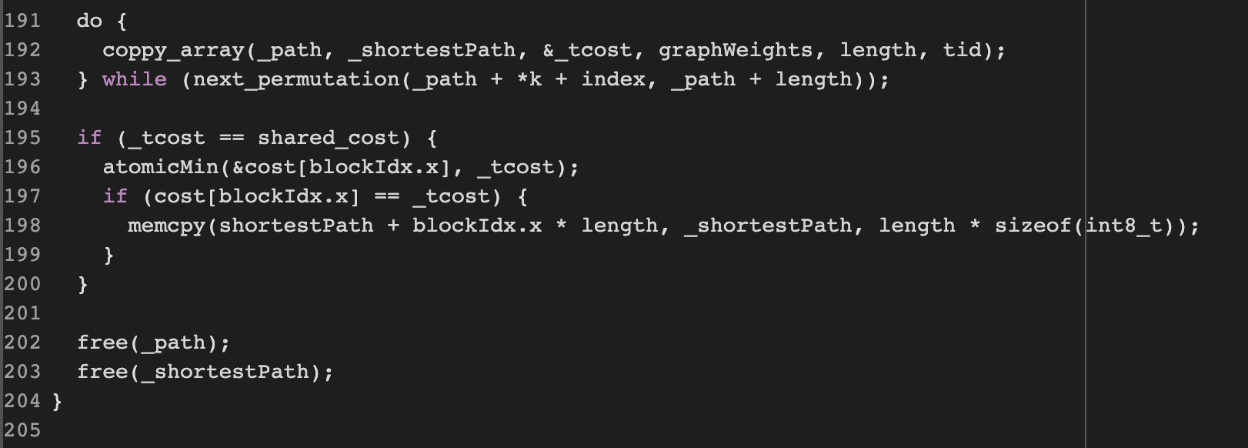
Cuda Implementation

Slide 7
Results
Problem size | 4 | 6 | 8 | 10 | 11(S)-12(C) | 14
Serial Implementation | 0.005 | 0.019 | 0.26 | 26.17 | 192.65 | -
Cuda Implementation | 0.29 | 0.22 | 2.89 | 28.43 | 128.94 | 38956.66

Slide 8
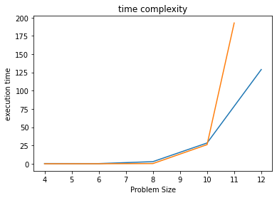
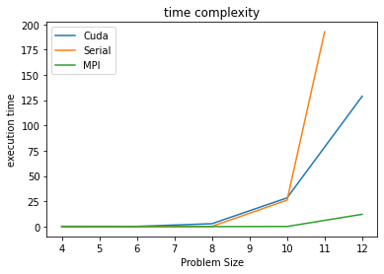
Results
Problem size | 3 | 5 | 7 | 9 | 10 | 11
Number of Permutations | 6 | 120 | 5040 | 362880 | 3,628,800 | 39,916,800

Slide 9
Results – Different Block Sizes
Block size 30 | 0.29 | 0.22 | 2.89 | 28.43 | 128.94 | 38956.66
Block size 15 | 0.30 | 0.22 | 2.90 | 26.7 | 129.44 | 67915.28
Block size 60 | 0.29 | 0.22 | 2.90 | 28.52 | 129.18 | 42514.27

Slide 10
Simulated annealing
“Simulated annealing (SA) is a probabilistic technique for approximating the global optimum of a given function.”
https://en.wikipedia.org/wiki/Simulated_annealing

Slide 11
Usage of SA
Types of problems:
Optimization problems
Discrete, large problem spaces
Problems with many local minima where other algorithms may get stuck
Exact solution isn’t required; suboptimal is good enough
For example:
Traveling salesman, scheduling problems, graph colouring, IC design
Notes:
→ Additional example, protein structure prediction

Slide 12
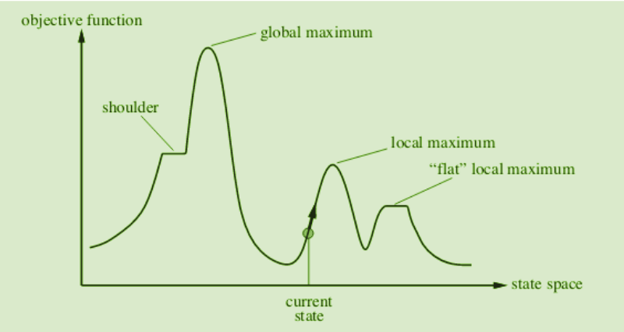
Example
https://www.geeksforgeeks.org/introduction-hill-climbing-artificial-intelligence/
Notes:
→ Improvement on the hill climbing algorithm
→ Describe locations where hill climbing algorithm may get stuck

Slide 13
Algorithm Overview
Set an initial state and temperature
Loop until a termination condition is met
At each iteration:
Decrease temperature
Pick a random neighbour state
Calculate probability of accepting neighbour state, P
Compare P against a random number between 0 and 1
Accept neighbour state if P is greater than random number
Return the final state
Notes:
→ Initial state can be based on prior knowledge or random
→ Temperature is positive
→ Termination could be max iterations, performance threshold, etc.

Slide 14
Algorithm Parameters And Functions
Parameters:
s → current state
T → temperature
L → current iteration
Functions:
Temperature
Neighbour
Energy
Probability

Slide 15
Code Design
Input: The WGS84 representation of Canadian cities.
Distance: Use Haversine formula to calculate the distance between two cities.
Annealing Schedule: T = T0*0.98
Neighbour: Switch the order of two cities.
Energy: The total distance for the current solution
Probability: Metropolis,which use the formula e^(-dE/T)

Slide 16
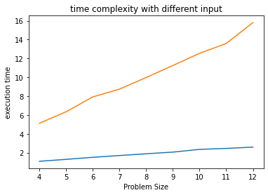
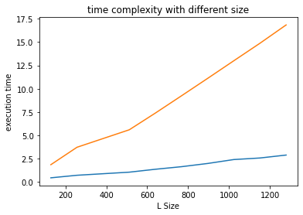

Slide 17
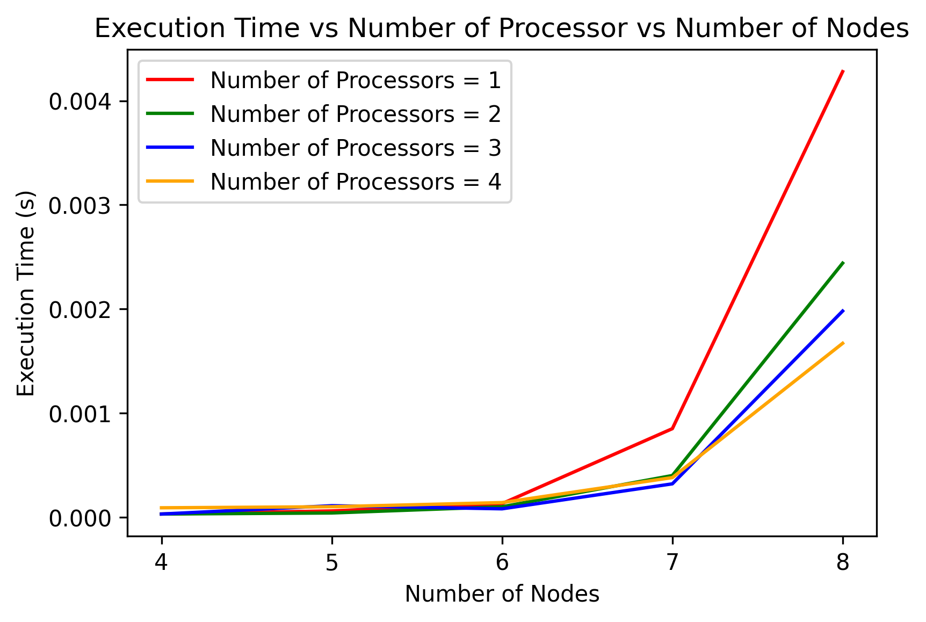
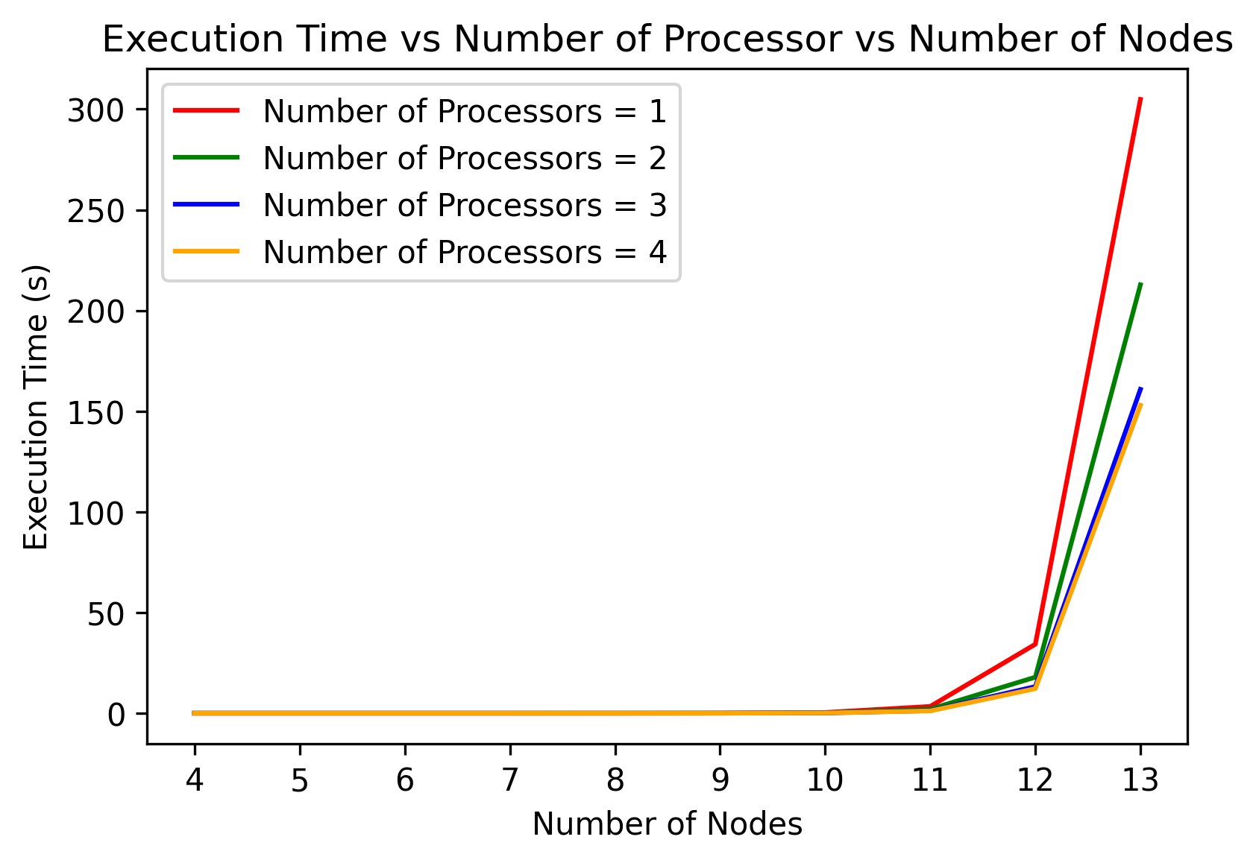
MPI (Message Passing Interface)
With 8 Nodes
With 13 Nodes

Slide 18
Questions?
Thanks for listening!
Notes:
Intros → Names, programs, research interests

